Slide 1
Attendance Management System with Face Recognition

Slide 2
SUBMITTED BY ---------
AFROZ AMAN
ANISHEK GULSHAN
ARNAB KUMAR SINGHA
ALIVA BAIN

Slide 3
Introduction
Automate attendance tracking using facial recognition for enhanced accuracy and efficiency.
Technology Stack: Developed with Python, OpenCV, Tkinter, and MySQL.
Core Feature: Utilizes the Local Binary Patterns Histogram (LBPH) algorithm for reliable face recognition.
Purpose: Replace traditional attendance methods prone to errors and fraud.
User Interface: Intuitive GUI ensures ease of use for both administrators and users.
Key Benefits: Reduces administrative workload, improves security, and ensures scalability for diverse applications.

Slide 4
System Overview
Core Components:
Face Recognition System: Implements the LBPH algorithm for accurate identification.
Database Management: Stores attendance records and user profiles using MySQL.
User Interface: A Tkinter-based GUI for easy interaction and management.
Workflow:
User's face is captured via a camera.
The face is processed and matched against stored data in the database.
Attendance is automatically marked upon successful recognition.
Key Functionalities:
Real-time face detection and recognition.
Storage and retrieval of attendance records.
User management features like adding or updating profiles.
Scalability: Designed to handle multiple users and large datasets efficiently.
Integration: Seamless interaction between the GUI, database, and recognition module for optimal performance.

Slide 5
Technical Stack
Programming Language:
Python: Core language for development, ensuring flexibility and extensive library support.
Libraries and Frameworks:
OpenCV: Used for image processing and face recognition.
NumPy: Supports numerical computations and array handling.
Pillow: For image manipulation within the GUI.
Tkinter: Creates a user-friendly graphical interface for system interaction.
Algorithm:
LBPH (Local Binary Patterns Histogram): Provides robust and reliable face recognition, even in challenging conditions.
Hardware Requirements:
Camera: Essential for capturing facial data.
System with Python and MySQL installed.
Operating System Compatibility:
Cross-platform support on Windows, macOS, and Linux.
Notes:
Database:
MySQL: Stores user profiles and attendance records for efficient data management

Slide 6
Key Features
Face Recognition: Utilizes the LBPH algorithm for accurate and efficient facial identification.
Automated Attendance Marking: Eliminates the need for manual intervention, ensuring error-free records.
Database Integration: Attendance data and user profiles are securely stored and managed in MySQL.
User-Friendly Interface: Built with Tkinter for seamless interaction and ease of use.
Real-Time Processing: Recognizes faces and marks attendance instantly.
Scalability: Capable of handling a growing number of users and attendance records efficiently.
Customizability: Modular design allows easy updates and integration of additional features.
Accuracy in Diverse Environments: Works effectively under varying lighting and background conditions.
Data Export Options: Attendance reports can be exported to Excel for further analysis.
Security Features: Prevents attendance fraud by uniquely identifying users based on facial data.

Slide 7
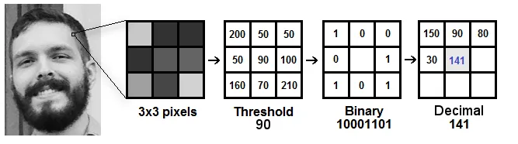
Some more details about Local Binary Patterns Histograms (LBPH)

Slide 8
Installation Guide
Install Python:
Download and install the latest version of Python from python.org.
Install Required Libraries:
Use pip to install the necessary libraries: pip install opencv-python opencv-contrib-python numpy pillow mysql-connector-python
Set Up MySQL:
Install MySQL and create a database for attendance management.
Import the required tables using the provided SQL script.
Configure Database Connection:
Update the database credentials in the code (e.g., host, user, password).
Install Camera Drivers:
Ensure your system camera is functional or connect an external camera.
Run the Project:
Open the terminal in the project directory and run the main Python file: python main.py
Check Compatibility:
Ensure your system supports the required Python and library versions.
Notes:
Install Tkinter (if not pre-installed):
For Linux: sudo apt-get install python3-tk

Slide 9
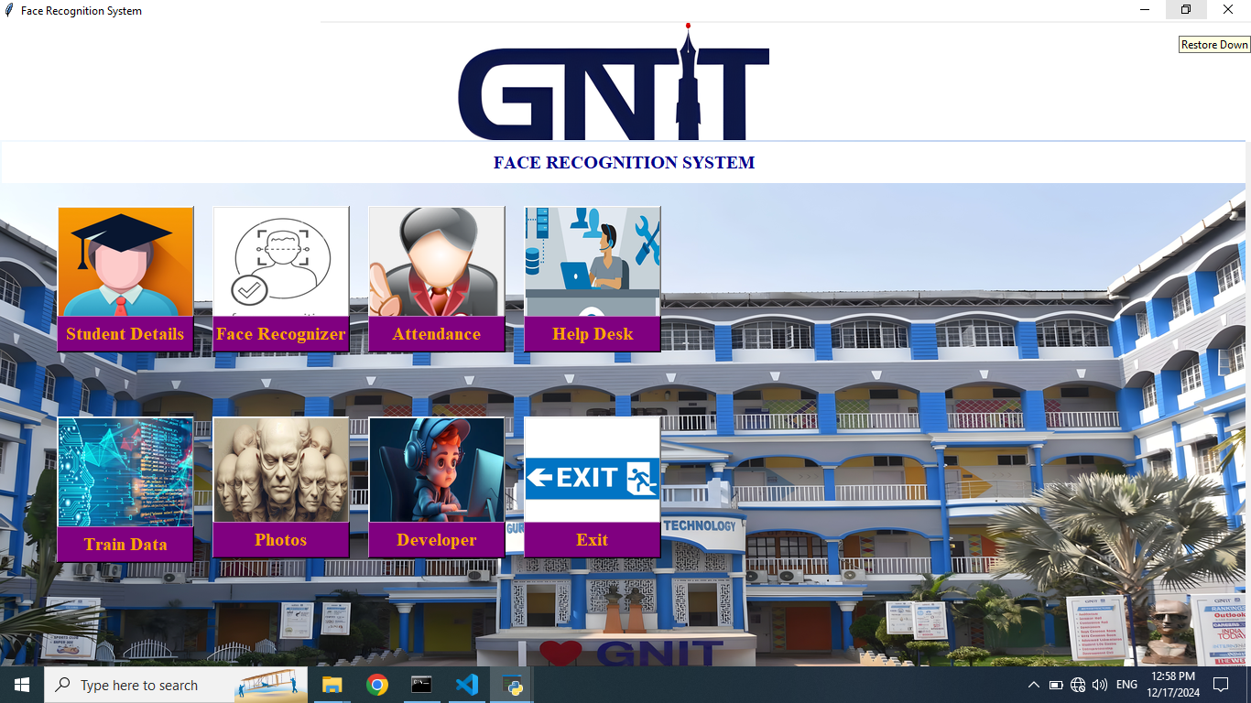

Slide 10
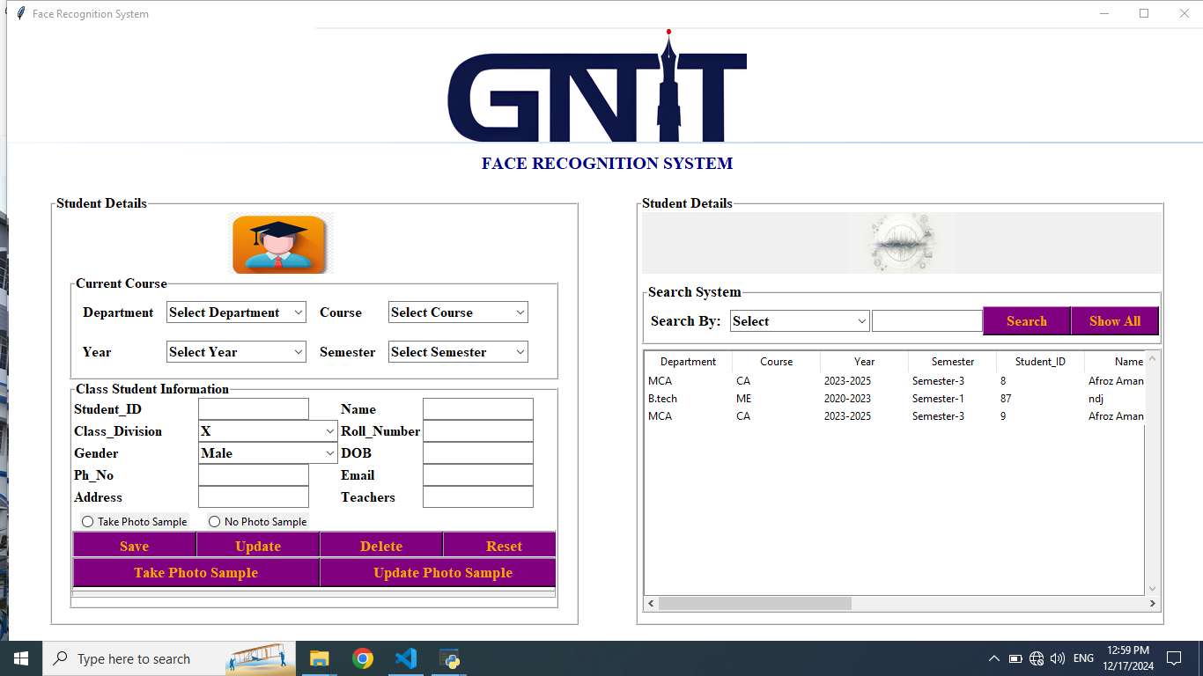

Slide 11
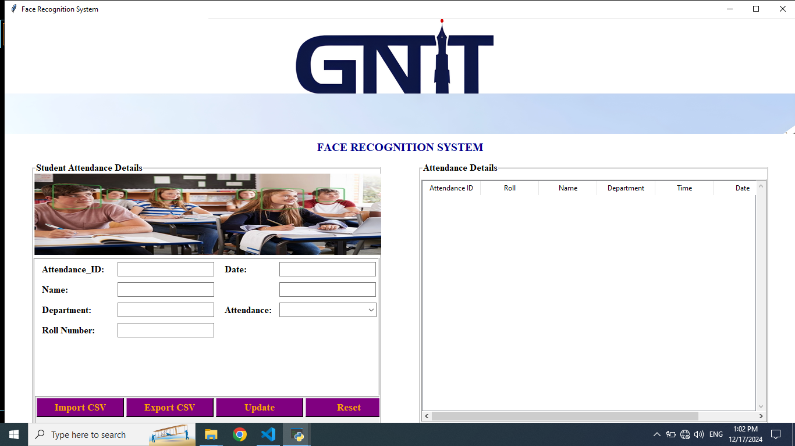

Slide 12
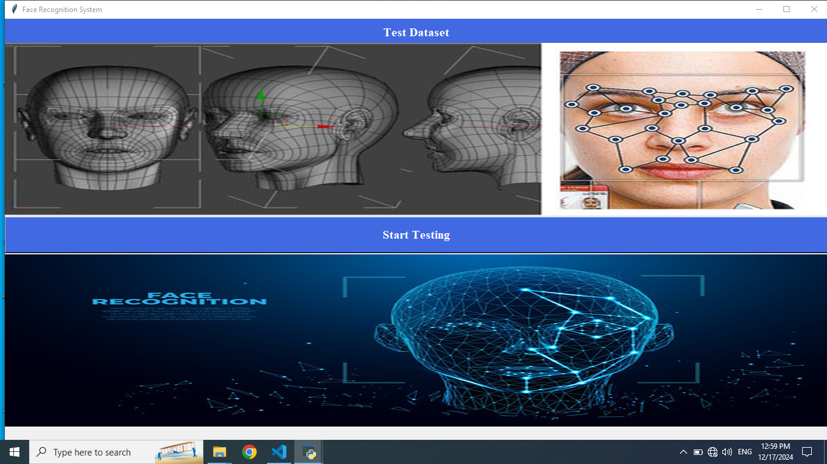

Slide 13
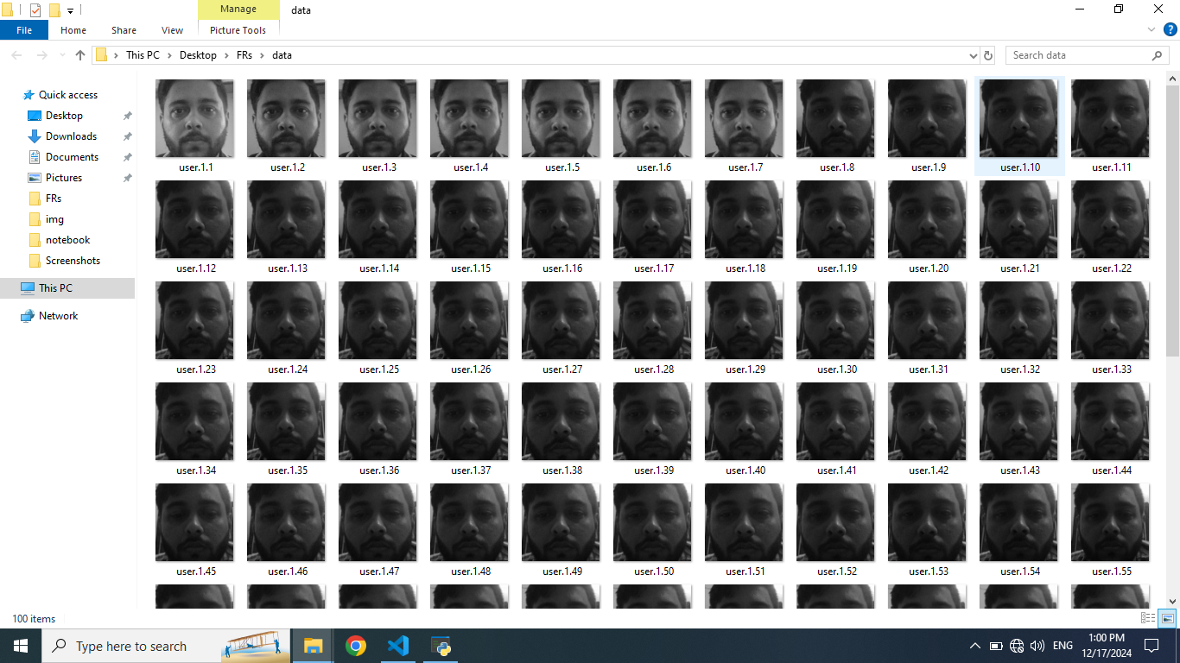

Slide 14
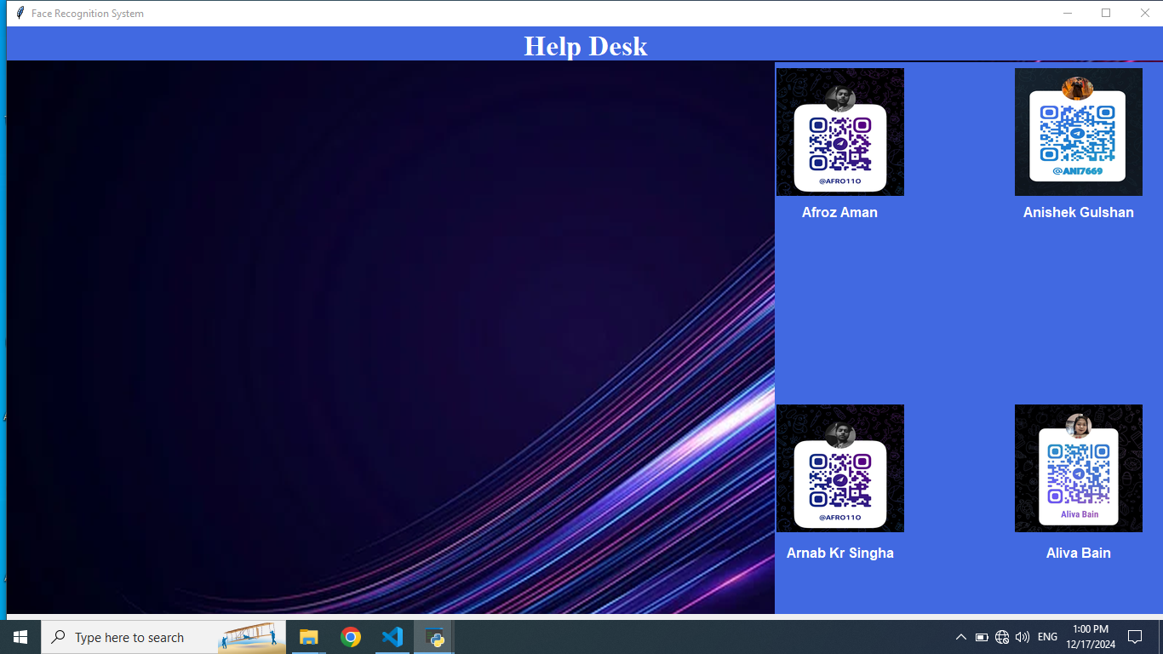

Slide 15
Implementation Details
Face Recognition: Uses LBPH algorithm for accurate face matching.
GUI: Built with Tkinter for user-friendly interactions like attendance tracking and user management.
Database: MySQL stores user profiles and attendance records efficiently.
Modules:
Attendance Module: Automatically marks attendance upon recognition.
Training Module: Trains the model with new facial images.
Export Feature: Allows attendance records to be exported to Excel.
Workflow: Capture → Recognize → Record attendance in the database.
Error Handling: Manages unrecognized faces, database errors, and lighting issues.
Hardware: Requires a functional camera and system with Python and MySQL installed.

Slide 16
Challenges and Limitations
Lighting and Environmental Conditions:
Face recognition accuracy can drop in low-light or cluttered backgrounds.
Database Scalability:
Managing large datasets can strain system performance.
Hardware Dependency:
Performance depends on camera quality and system hardware.
Privacy Concerns:
Collecting and storing facial data raises security and privacy issues.
Integration with Existing Systems:
Compatibility challenges when integrating with other attendance systems.
Network Dependency:
Real-time updates may be delayed due to unstable internet connections.

Slide 17
Future Enhancements
Improved Facial Recognition: Enhance accuracy under challenging conditions.
Advanced Machine Learning Models: Implement deep learning for better recognition.
Enhanced User Interface: Add analytics and performance tracking features.
Cloud Integration: Improve data scalability and accessibility.
Real-Time Data Analytics: Monitor attendance trends and performance.
Mobile App Integration: Enable remote attendance marking via smartphones.
Improved Security Features: Implement multi-factor authentication.
Automatic Model Updates: Keep the model current with new faces.
User Feedback: Incorporate user feedback for continuous system improvement.

Slide 18
Conclusion
The Attendance Management System with Face Recognition provides an efficient solution for managing attendance.
Utilizes advanced technologies like the LBPH face recognition algorithm, MySQL, and Tkinter.
Faces challenges such as lighting conditions, hardware dependency, and privacy concerns.
Future enhancements include cloud integration, advanced machine learning models, and improved security features.
Continual refinement can enhance accuracy, security, and usability.
Valuable tool for educational institutions and organizations.

Slide 19

Thank you

